Slide 1
MagicBook
Project Fizzyo
Team 3
COMP103P Team 37

Slide 2

Concept: Idea and Inspiration
MagicBook:
The idea is to create a virtual, interactive book
By breathing, the words magically appear on the page.
Inspiration:
Children’s reading books
Apps for children already on the market
e-Book readers and reading applications

Slide 3
Game Play Mechanics
Breath Control:
Used to make the words appear on the page
“Bad breaths” will make the words appear faded
“Good breaths” will be rewarded
Button:
Used to control the speed of text appearing on the page
Touch:
Used for menus and navigation

Slide 4
Achievements and Rewards
Rewards:
For how many pages have been read
For completing a chapter
For performing a number of “good breaths” consecutively
For opening the app for a certain number of days in a row

Slide 5
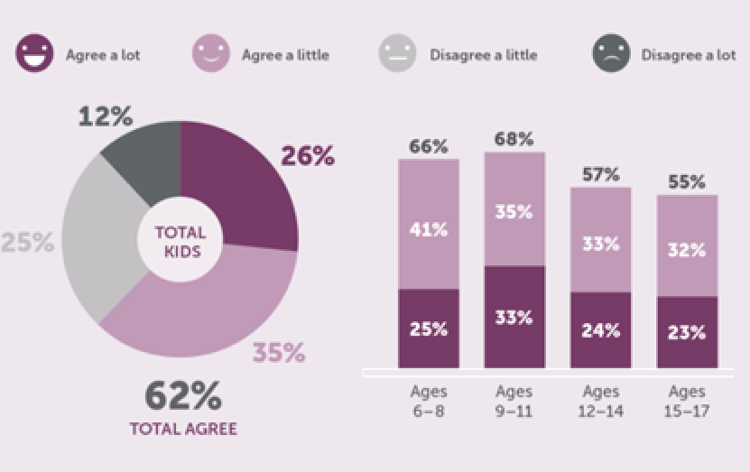
Gamification: Why children will play this
Most children like reading: makes reading more accessible
“Addictive”: Interesting story, with achievements to reward progress
Doesn’t get boring over time, good retention
Children agree with the statement:
“I enjoy reading over summer”

Slide 6
Milestones and Responsibilities
Milestones:
Completed a full requirement analysis for the game
Designed UI and screen flow
Analysed the technology to be used (Unity)
Beginning work on the first prototype
Responsibilities:
Divided equally amongst the team
Tasks based on individual strengths

